Slide 1

HOSPITAL MANAGEMENT SYSTEM
Adabala Aparna Latha(Team Lead) -22221A0501
Devudu Bala Dhana Ganesh -22221A0526
Annamneedi Veera Aparna -22221A0508
Project Coordinator : Mr.M.V.K.Subash -M.Tech(Ph.D)
Project Supervisor & HOD: Prof. Meerasharif Sheik –M.Tech,Ph.D
Dept. of Computer Science and Engineering, BVCEC(A)
1

Slide 2
INTRODUCTION TO THE PROJECT
A web-based application designed to modernize healthcare management.
Automates hospital operations including registration and role-based data management.
Ensures secure authentication and reliable access to digital records.
2

Slide 3

Project Overview
1
2
3
Problem
Solution
Key Benefits
Manual record-keeping leads to delays and fragmented paper files.
A 'Smart' platform integrating patient profiles and doctor schedules.
Improves efficiency through automated notifications and digital reports.

Slide 4
Technologies and Tools Used
Frontend:
React (powered by Vite) using JSX and CSS.
Backend:
Java with Spring Boot framework and RESTful APIs.
Database:
MySQL for secure and structured data storage
Security:
Spring Security and JWT-based authentication.
Tools:
VScode, Eclipse, Command Prompt, SpringBoot.
4

Slide 5


MODULES
Involved:
Admin Management Module:
Centralized system control.
Doctor Management Module:
Handling profiles and consultations.
Patient Management Module:
Medical history and profile tracking.
Appointment & Notification Modules:
Scheduling and automated reminders.
5

Slide 6


ADMIN
Module:-
Centralized Oversight:
High-level view of all hospital operations.
User Governance:
Full authority to add, update, or remove
doctor and patient accounts.
Data Control:
Only authorized personnel can verify
sensitive medical records.
6

Slide 7


ADMIN
Module:-
Global Settings:
System Analytics:
Configures core system
settings and emergency
alerts.
Real-time statistics
for patient counts
and active doctors.
Security Enforcement:
Manages role-based
access control (RBAC).
7

Slide 8

DOCTOR
Module:-
1
Professional Registration:
Dedicated interface to specify area of
specialization.
Profile Management:
2
Doctors manage their own consultation
availability.
Accessibility:
3
Supports both in-hospital and
teleconsultation services.
8

Slide 9
DOCTOR
Module:-
Issue treatment plans directly through
the portal.
Medical Record Access:
1
View patient history, prescriptions,
and lab reports.
Digital Prescriptions:
2
3
Daily Dashboard:
Focused view of daily appointments and
pending requests.
9

Slide 10

PATIENT
Module
Secure Registration:
Detailed profile creation including medical
background.
Digital Health Repository:
Access to personal prescriptions and
test results.
Easy Scheduling:
Form-based interface to book preferred time slots.
10

Slide 11

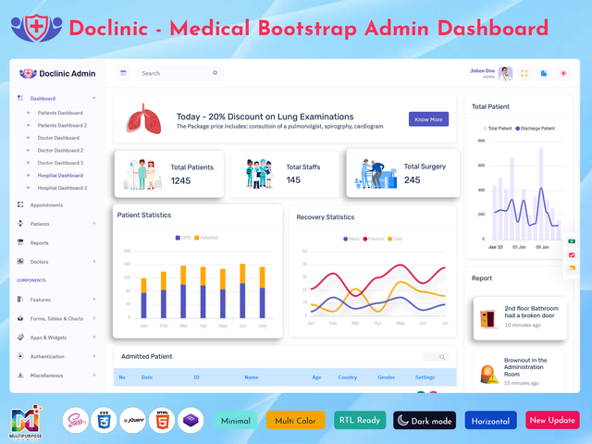
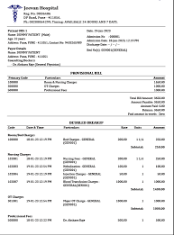

PATIENT
Module:-
Personal Dashboard:
Automated Reminders:
Billing Transparency:
Summary of upcoming
visits and health status.
Notifications for medication
and follow- ups.
Digital access to all billing
and payment history.
11

Slide 12

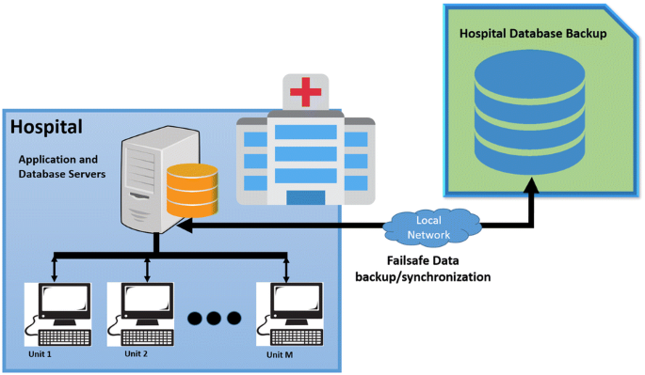
SYSTEM
Architecture
Model:
Data entities (User, Patient, Doctor)
mapped via Hibernate.
Controller:
Spring Boot controllers handling business
logic and API requests.
View:
React-based frontend providing the
user interface.
Workflow:
Frontend -> REST API -> Backend Service
-> Database.
12

Slide 13
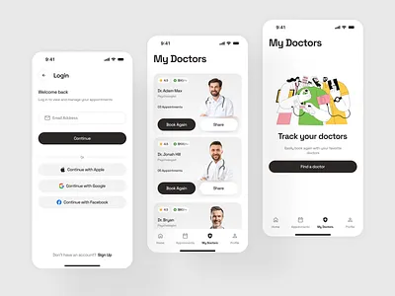
Results and Conclusion
Result:
Successfully implemented role-based
security and data integrity.
13

Slide 14


Conclusion :
Provides a scalable and secure solution
to modern healthcare challenges.
14

Slide 15

THANK YOU
15

